Slide 1

Autism Hackathon Use Case 3: Machine Learning
Presented by: Noha Elprince, Olive Kingsley, Hanen Bondka, Anita Mohanani, Rishi Bhatnagar, Dhruv Bhatnagar, Peter Shand, Halaa Menasy, Adam Pryce, Ryan Carpenter
SME: Richard M Kubina, Nate Green

Slide 2

AGENDA
Problem Statement
Executive Summary
Approaches
Insights
Appendix: Dimensionality reduction techniques:
PCA
T-SNE (visualization)
Clustering Model
Clustering Analysis

Slide 3
Problem Statements
Problem Statement #1 - Identify peer group for a patient to compare progress against
Problem Statement #2 - Determine whether progress is being made based on assessment

Slide 4
Executive Summary

Slide 5
Methodology
Visualization of different patterns
tSNE
dataset
PCA
Cluster Model (K-Means, GMM)
Important cluster variables
Cluster profiling
Principal component analysis (PCA) is a statistical procedure that is used to reduce the dimensionality. It finds a new set of dimensions such that all the dimensions are orthogonal (and hence linearly independent) and ranked according to the variance of data along them.
t-SNE is A very popular and state of the art dimensionality reduction technique and data visualization and can even be used for outlier detection. It is used to map high dimensional data to 2 or 3 dimensions in order to visualize it. It does so by computing affinities between points, and trying to maintain these affinities in the new, low-dimensional space
Cluster Labelling
insights

Slide 6
Insights
Data cleaning
E.g., future dated assessments, date of births, etc.
Selecting the right model
Cluster analysis
Data analysis
Its not just numbers
Lean metadata about the assessment
Visualizing the data

Slide 7

Appendix: PCA

Slide 8
How PCA reduces dimensions of the data?
Remove redundancy + Keep the most important information
I. Keep the most important info. we want the data to be spread out across each dimension (maximize variance)
II. Remove Redundancy
we want the dimensions to be independent

Slide 9
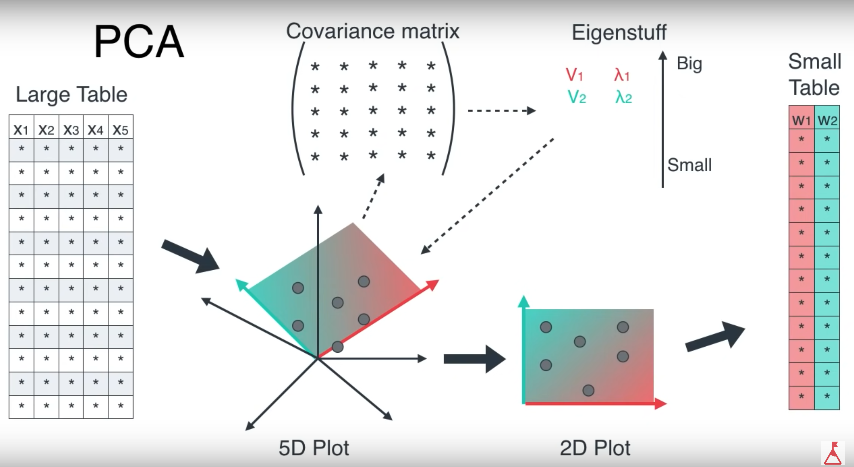


How does PCA works?
Calculate the covariance matrix X of data points.
Calculate eigen vectors and corresponding eigen values.
Sort the eigen vectors according to their eigen values in decreasing order.
Choose first k eigen vectors and that will be the new k dimensions.
Transform the original n dimensional data points into k dimensions.
K=2, n=12, m=5
,

Slide 10
Appendix: T-SNE

Slide 11
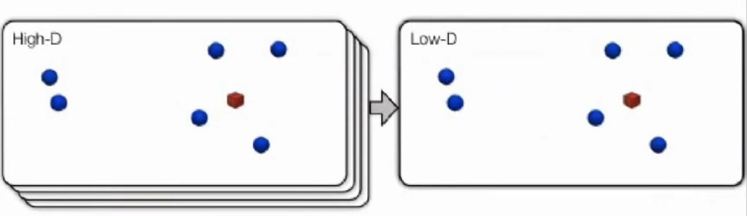
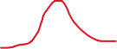
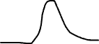
What is T-SNE? t-Distributed Stochastic Neighbor Embedding
Student T-Distribution
z
z’
y
y’
x
x’
The similarity of datapoint x to datapoint y is defined as the conditional probability, p(y|x), that x would pick y as its neighbor if neighbors were picked in proportion to their probability density under a Gaussian centered at x
Minimize objective function Kullback Leibler Divergence (KL) that measures the discrepancy between similarities in the original data and similarities in the map using Gradient Descent => help preserves local structure
Check this video for more info about KL:
https://www.youtube.com/watch?v=xjKm4BcwqX8

Slide 12
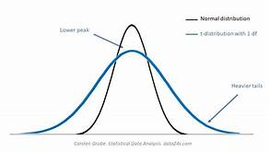
How t-SNE works?
Uses student-T distribution kernel (with 1df) instead of Gaussian kernel
Since it has more heavy/fatter tails than Gaussian which allow dissimilar points to be mapped too far apart in the low dimensional data => high variability in the data. This reduces the crowding problem.
Reduced the computation complexity (easier in derivatives computation)
In the computation of t-SNE, a parameter is called ‘perplexity’, which can be interpreted as a smooth measure of the effective number of neighbors, whose typical value is between 5 and 50.

Slide 13
T-SNE VS PCA
Metrics | PCA | T-SNE
Year of release | 1933 | 2008
Type of dim. reduction | Linear | Non-Linear
How it works | maximize variance (minimize squared error between distances in the original data and distances in the low dimensional data) | calculates a similarity measure between pairs of instances in the high dimensional space and in the low dimensional space. It then tries to minimize these two similarity measures using a cost function(Kullback-Liebler divergence) using Gradient Descent
Goal | Preserves large pairwise (global) distances | Preserves small pairwise distances (local similarities)
Visualization quality for complex high dimensional data | Poor (square error preserves only large distances) | Excellent (Usually show clear separation in the data)

